Slide 1
COSC 6373: Computer Vision Spring 2023
Face Detection in Large Distance(FaDiLD)
Final Presentation
Jiechang Guo, Meng-Chen Lee
Mentor: Dr. Christos Smailis
Department of Computer Science
University of Houston

Slide 2
Outline
What is long distance?
Motivation
Challenges
Background
Data
Methodology
Evaluation
Experiment
Result
Future Work
Notes:
First, we will talk about the motivation of this project. Then, specify the difficulties of the task. Demonstrating some state-of-the-art works, and their methods. And how to evaluate the results. Last, showing our progress and future work.

Slide 3
Long Distance
Indoor: 10 – 20 meters
Outdoor: 50 – 300 meters
Y. Yao, B. Abidi, N. D. Kalka, N. Schmid and M. Abidi, "High Magnification and Long Distance Face Recognition: Database Acquisition, Evaluation, and Enhancement," 2006 Biometrics Symposium: Special Session on Research at the Biometric Consortium Conference, Baltimore, MD, USA, 2006, pp. 1-6, doi: 10.1109/BCC.2006.4341635.
http://biometrics.cse.msu.edu/Publications/Face/Choietal_FaceTrackingRecognitionDistancePTZCameraSystem.pdf

Slide 4
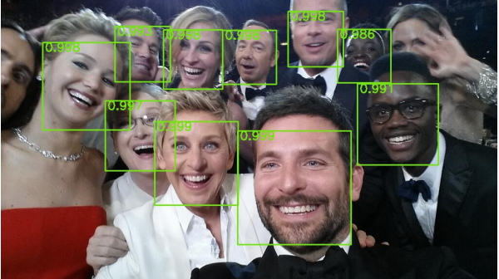
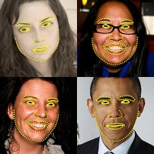
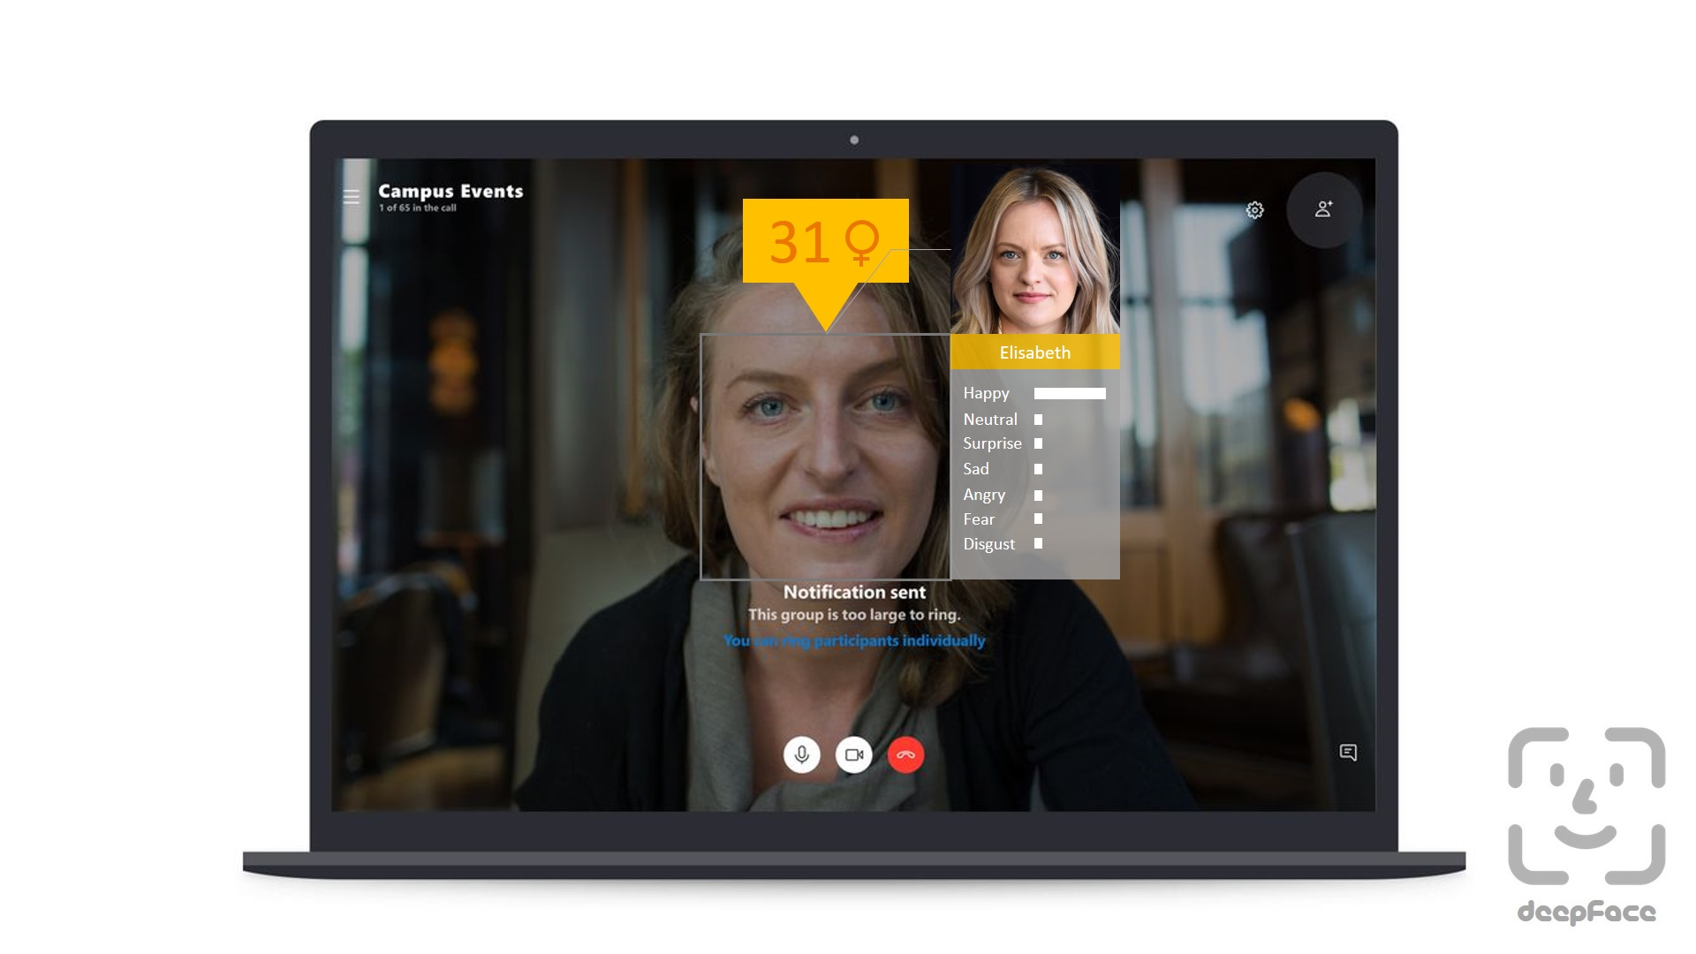
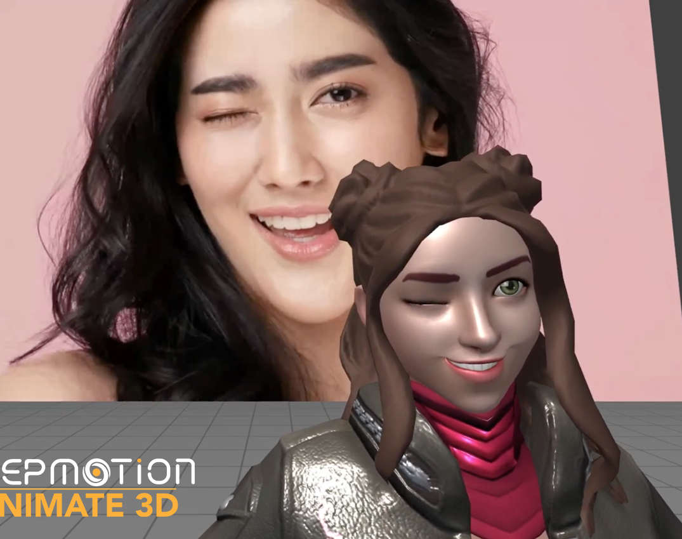
Motivation
Face Detection[1]
Face Landmark[4]
Face Recognition, Facial Expression[3]
Face Tracking[2]
[1] https://www.technologyreview.com/2015/02/16/169357/the-face-detection-algorithm-set-to-revolutionize-image-search/
[2] https://blog.deepmotion.com/2021/07/02/animate3d-facetracking/
[3] https://github.com/serengil/deepface
[4] https://docs.opencv.org/3.4/d2/d42/tutorial_face_landmark_detection_in_an_image.html
Notes:
Why is face detection so important?
Face detection is the first step for many face-related applications, such as face recognition, face tracking, facial expression recognition, facial landmarks detection and so on. Those technologies can achieve an overall better performance by faster and more accurate face detectors.
Other than that, face detection itself is also important, especially at long distances.
Like the need for surveillance and security applications. With the ability to detect faces at long distances, cameras and other surveillance systems can cover larger areas, leading to more effective monitoring and tracking of individuals. Face detection at long distances can also be used in other applications, such as tracking suspects in a high-speed chase or persons of interest in search and rescue operations. With the increasing use of surveillance cameras and other systems, the need for accurate and efficient face detection at long distances will likely continue to grow.

Slide 5
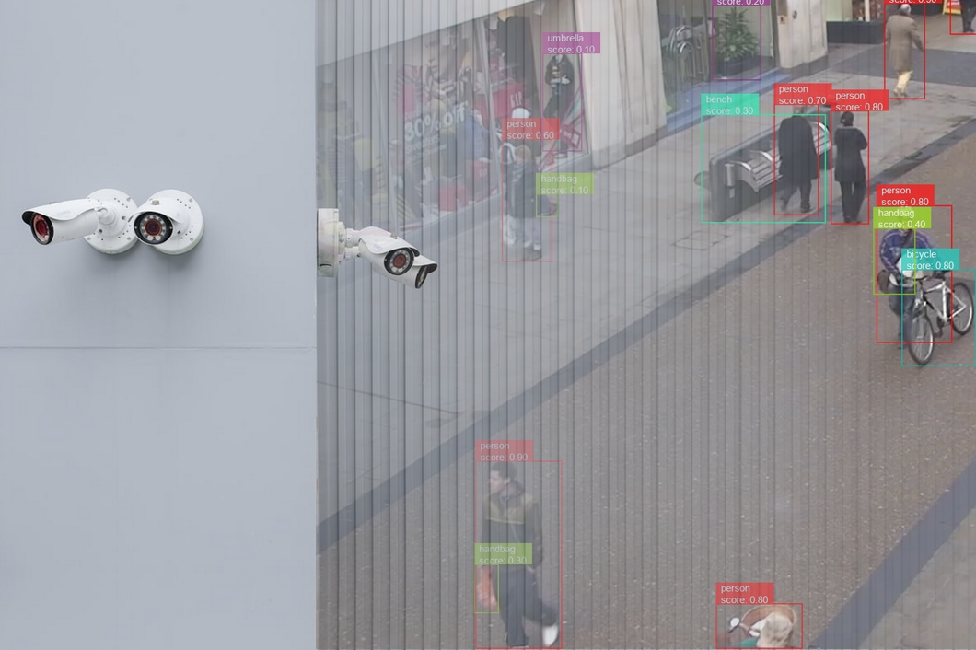
Motivation
https://viso.ai/wp-content/uploads/2022/06/computer-vision-surveillance-security-applications.png
Notes:
Other than that, face detection itself is also important, especially at long distances.
Like the need for surveillance and security applications. With the ability to detect faces at long distances, cameras and other surveillance systems can cover larger areas, leading to more effective monitoring and tracking of individuals.
Face detection at long distances can also be used in other applications, such as tracking suspects in a high-speed chase or persons of interest in search and rescue operations. With the increasing use of surveillance cameras and other systems, the need for accurate and efficient face detection at long distances will likely continue to grow.

Slide 6
Challenges of Face Detection in Large Distance
Low Resolution
Variations in illumination
Variations in pose and orientation
Occlusion
Background noise
Notes:
So, what are the difficulties of face detection, especially in large distances.
Low resolution: At larger distances, the size of the face in the image becomes smaller, leading to lower resolution. This makes it difficult to detect and recognize the facial features.
Variations in illumination: At large distances, the face may be subjected to different lighting conditions, such as shadows, glare, or reflections. These variations in illumination can affect the quality of the face image and make it difficult to detect the face.
Variations in pose and orientation: At larger distances, the face may appear at different poses and orientations, making it difficult to detect the face using traditional face detection methods.
Occlusion: At larger distances, the face may be partially or completely occluded by other objects, such as hats, glasses, or other people. This makes it difficult to detect the face in the image.
Background noise: At larger distances, the background noise in the image can interfere with the face detection process. This can be particularly challenging in crowded environments where there are multiple objects in the image.

Slide 7
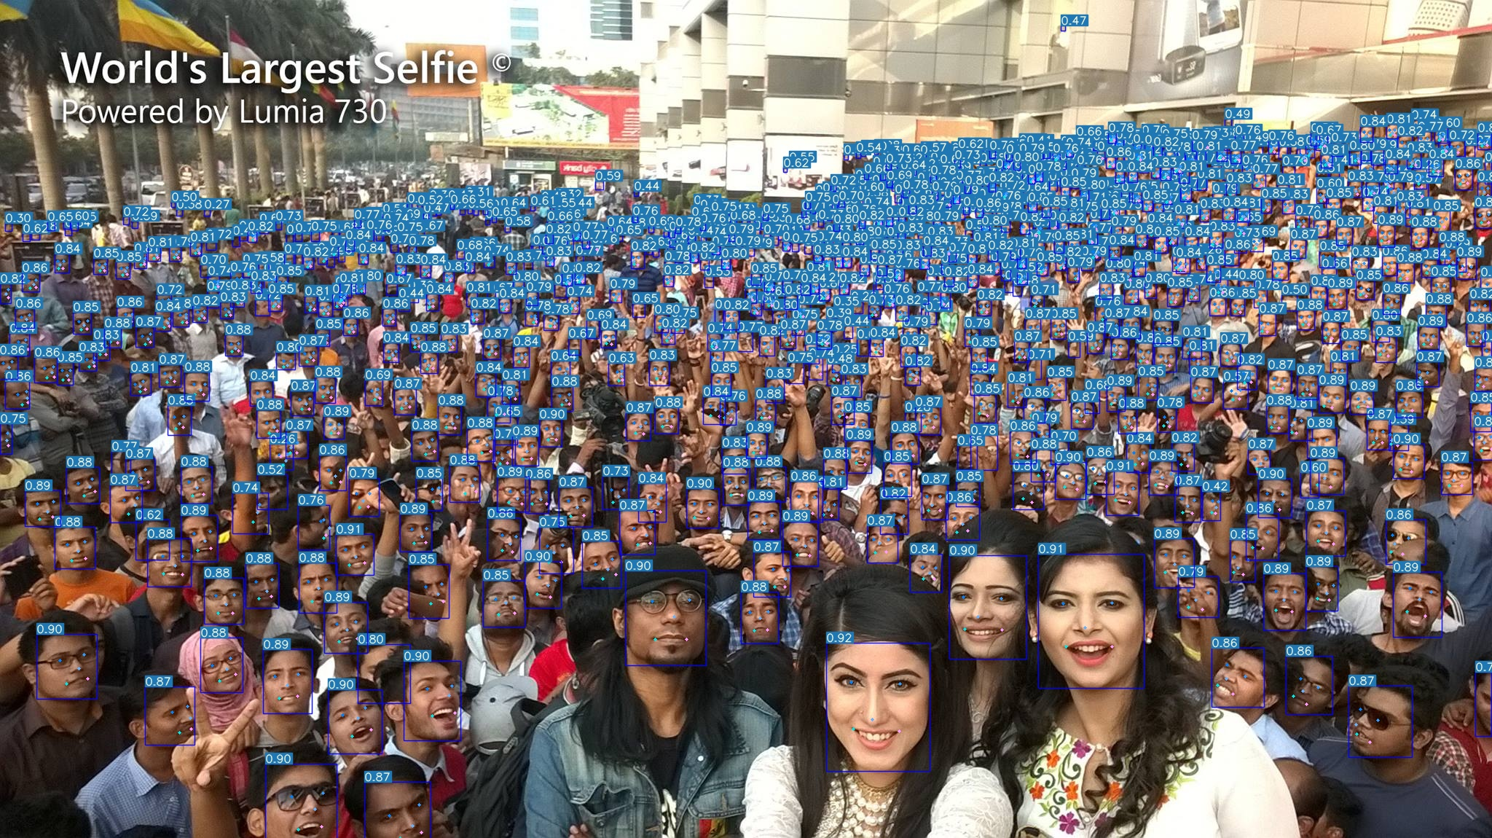
Background – YOLOv7 Face(Baseline)
Dataset: WiderFace, yolov7-face-label
https://github.com/derronqi/yolov7-face
Notes:
The baseline of our project is YOLOv7 Face, they adapted YOLO version 7 to do face detection. The model was trained on WiderFace and yolov7-face-label data.

Slide 8
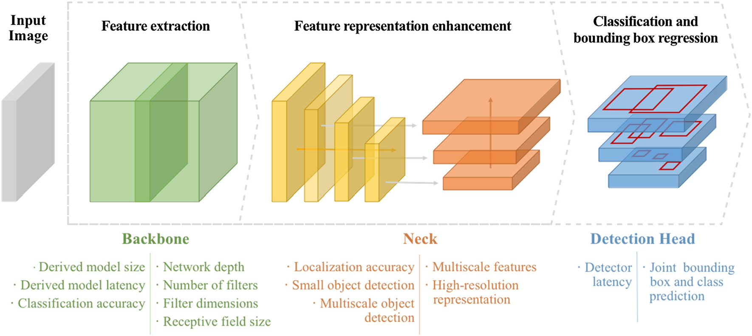
Background – Architecture
Optimized convolutional neural network architectures for efficient on-device vision-based object detection
Notes:
The backbone is used for feature extraction. It usually used a pretrained model to project the input images to feature maps.
The neck of the object detector refers to the additional layers existing between the backbone [1] and the head. Their role is to collect feature maps from different stages. The neck models are composed of several top-down paths and several bottom-up paths. The idea behind this feature aggregation existing in this model is to allow low-level features to interact more directly with high-level features, by mixing information from this high-level feature with the low-level feature.
Head is the last model of object detection, predicts bounding boxes and classes of objects

Slide 9
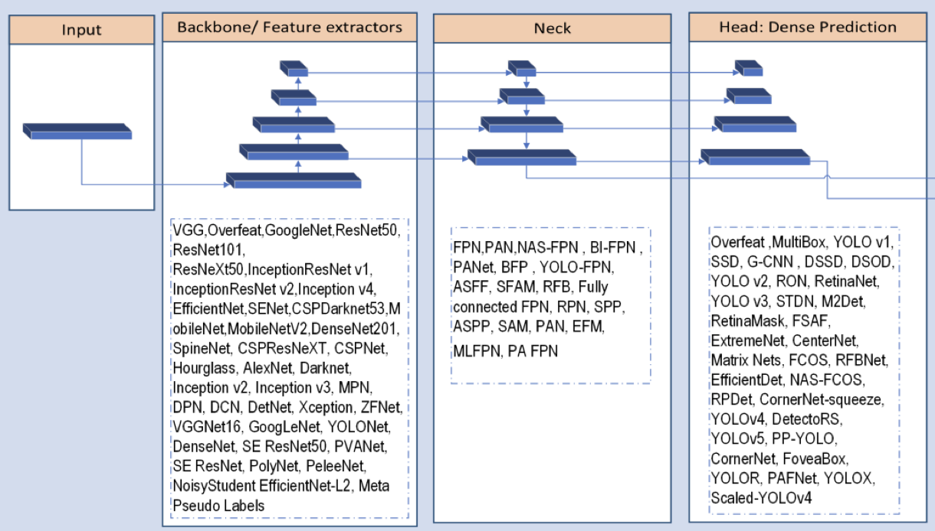
Background – Architecture
Deep Learning based Neck Models for Object Detection: A Review and a Benchmarking Study
Notes:
The neck of the object detector refers to the additional layers existing between the backbone [1] and the head. Their role is to collect feature maps from different stages. The neck models are composed of several top-down paths and several bottom-up paths. The idea behind this feature aggregation existing in this model is to allow low-level features to interact more directly with high-level features, by mixing information from this high-level feature with the low-level feature.

Slide 10
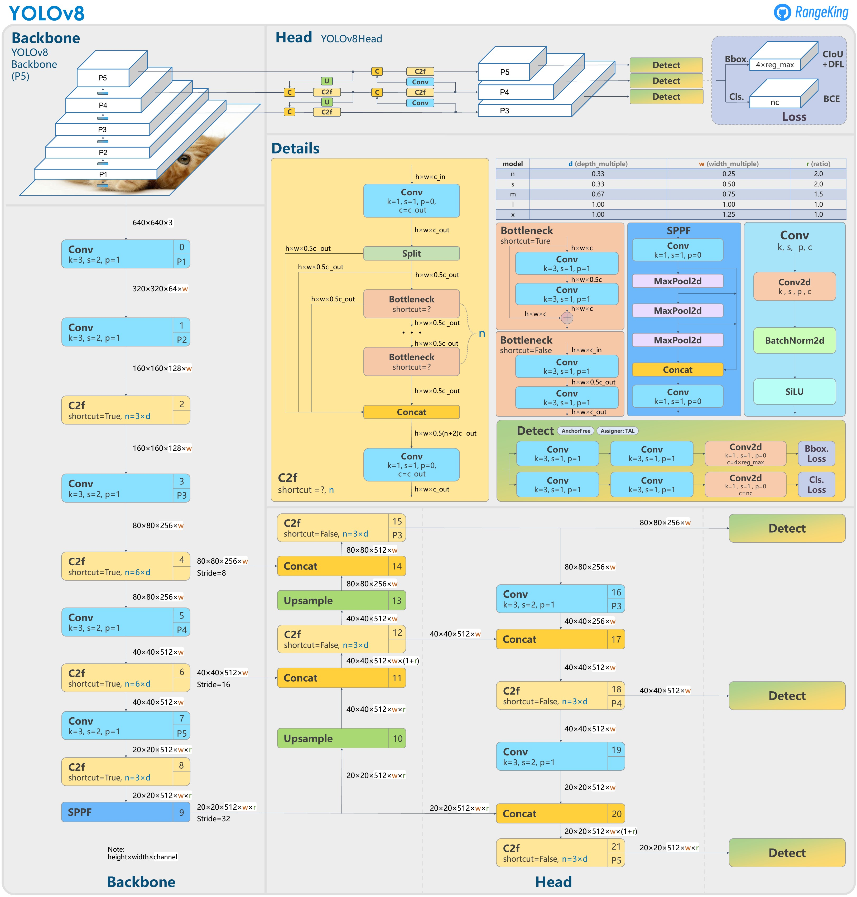
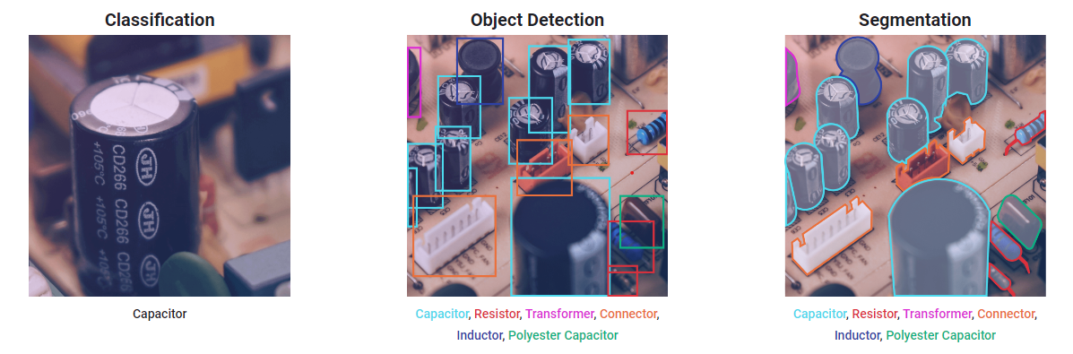
Background – YOLOv8
Anchor-free detection
https://ultralytics.com/yolov8
Notes:
Ultralytics YOLOv8, developed by Ultralytics, is a cutting-edge, state-of-the-art (SOTA) model that builds upon the success of previous YOLO versions and introduces new features and improvements to further boost performance and flexibility. YOLOv8 is designed to be fast, accurate, and easy to use, making it an excellent choice for a wide range of object detection, image segmentation and image classification tasks.
The paper of v8 isn’t released yet, so I’m not sure about the mechanism of anchor-free detection.

Slide 11
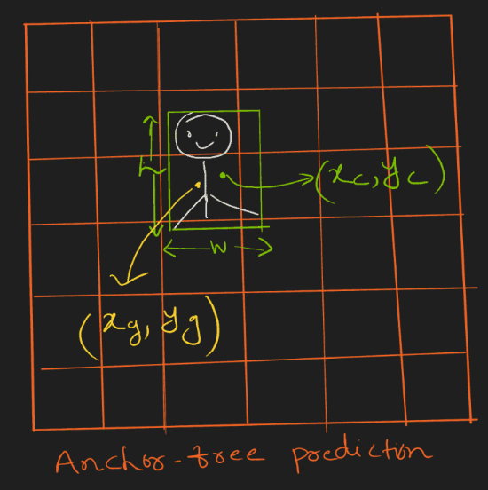
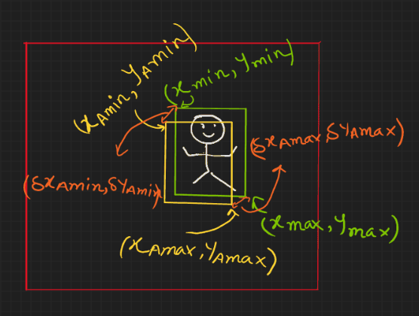
Core Techniques of Face Detection
Anchor based vs Anchor free
https://learnopencv.com/centernet-anchor-free-object-detection-explained
Notes:
Anchor boxes are a set of predefined bounding boxes with different aspect ratios and scales that are placed at various positions across the input image. During training, the algorithm learns to adjust the anchor boxes to better fit the ground truth bounding boxes of the faces in the image.

Slide 12


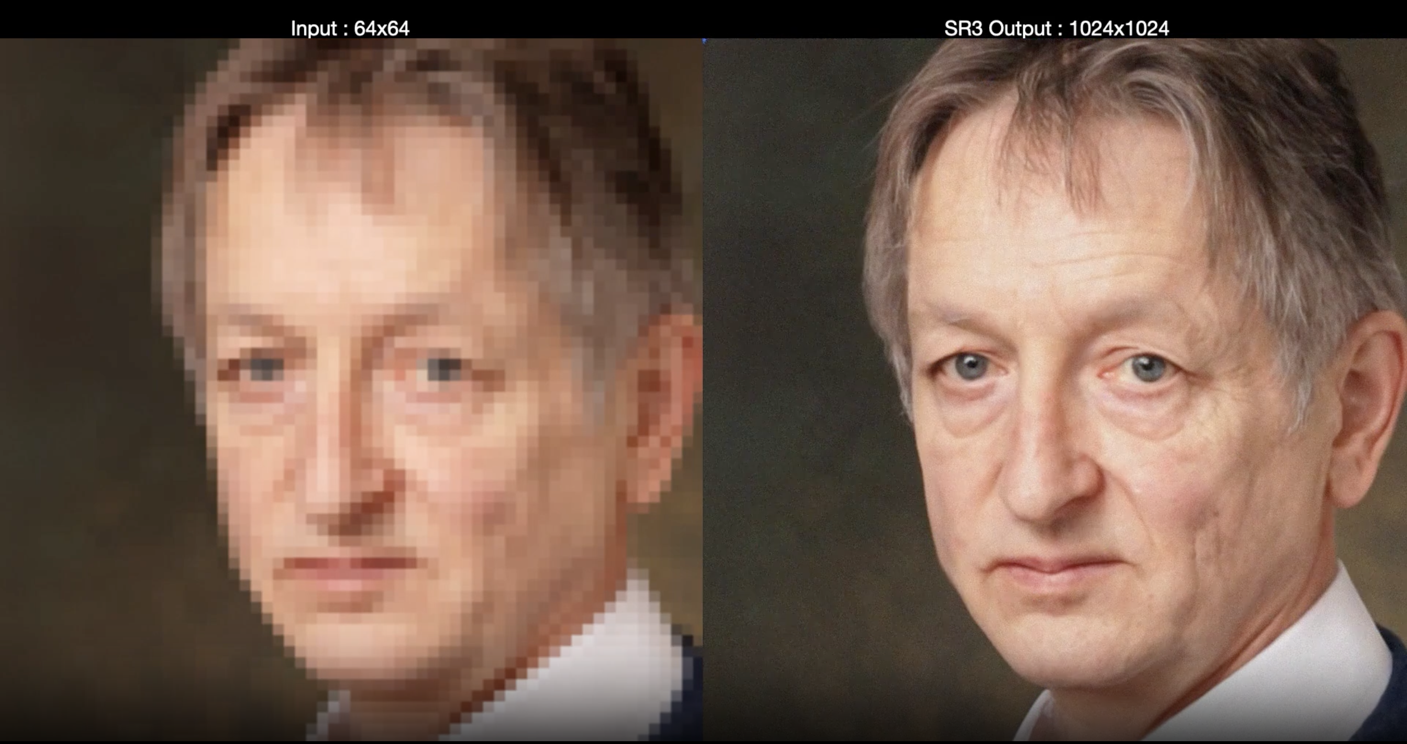
Methodology
WiderFace
https://ai.googleblog.com/2021/07/high-fidelity-image-generation-using.html
Notes:
Fine-tune YOLOv8 for face detection
YOLOv8 with Transformer
Modify the latest YOLOv8 architecture and combine with Transformer layer
Super Resolution
Enhance the resolution of image pixel by pixel

Slide 13
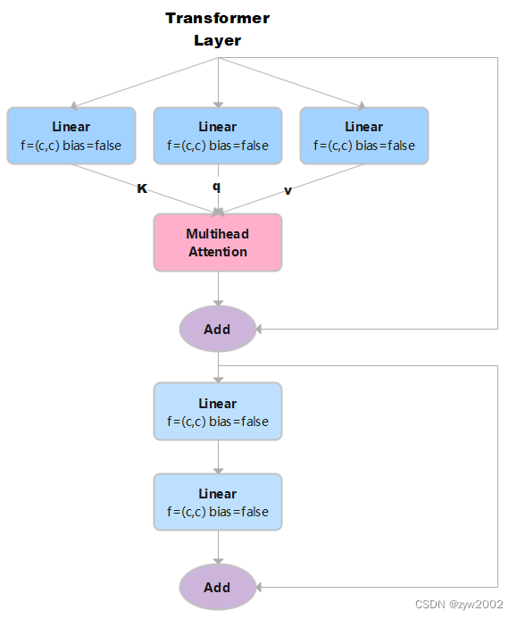
YOLO v8 with transformer
https://ultralytics.com/yolov8
Notes:
For this project, we introduce YOLO v8,
YOLO v8 is the state-of-the-art model, it supports detection, segmentation, pose estimation, and classification
Ultralytics YOLOv8, developed by Ultralytics, is a cutting-edge, state-of-the-art (SOTA) model that builds upon the success of previous YOLO versions and introduces new features and improvements to further boost performance and flexibility. YOLOv8 is designed to be fast, accurate, and easy to use, making it an excellent choice for a wide range of object detection, image segmentation and image classification tasks.
The paper of v8 isn’t released yet, so I’m not sure about the mechanism of anchor-free detection.

Slide 14
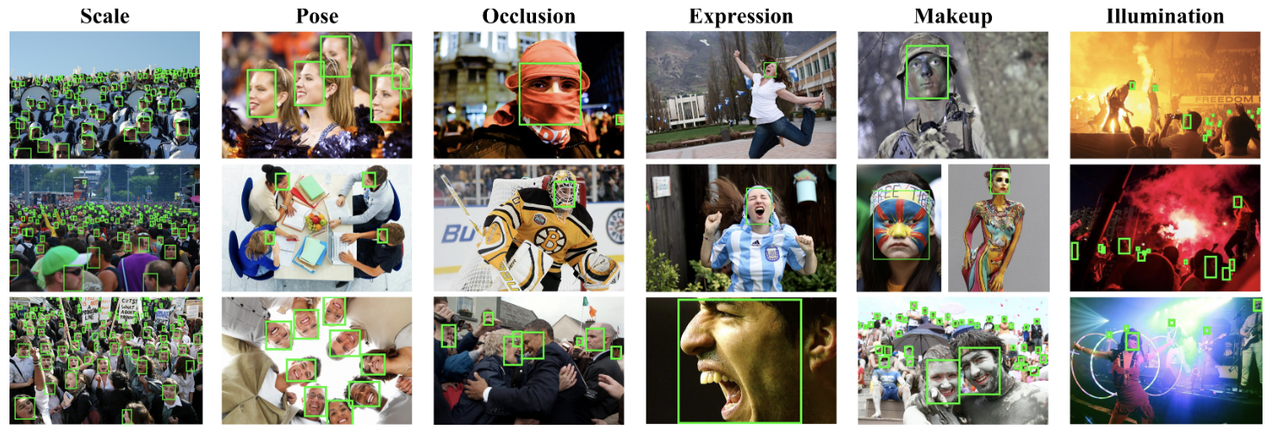
Data– WIDER FACE
32,203 images | 393,703 faces | 60 events
Train: 12,880 (40%)
Validation: 3,226 (10%)
Test: 16,097​ (50%) no ground truth
Easy: 41-60 event classes
Medium: 21-40 event classes
Hard:1-20 event classes
http://shuoyang1213.me/WIDERFACE/
Notes:
The dataset we use is the wider face which is the benchmark dataset for the task of face detection.
It includes more than 32 thousand images and labels more than 390 thousand faces in 60 different events covering a large number of scenes in the real world.
The dataset randomly splits into 40% of train data, 10% of validation data, and 50% of test data, however, the test data comes with no ground truth.
Based on the detection rate, the events are divided into easy, medium, and hard, and we will evaluate based on these levels.

Slide 15
Data– WIDER FACE
Bounding box | x1,y1,w,h
Blur | clean(0), normal blur(1), heavy blur(2)
Expression | typical expression(0), exaggerate expression(1)
Illumination | extreme(0), occlusion(1)
Invalid | false(0), true(1)
Occlusion | no occlusion(0), partial occlusion(1), heavy occlusion(2)
Pose | typical pose(0), atypical pose(1)
http://shuoyang1213.me/WIDERFACE/
Notes:
The faces come with a high degree of variability. The label for each image includes bounding boxes that indicate the position of the face and other attributes like blur, expression, illumination, validation, occlusion, and pose.

Slide 16
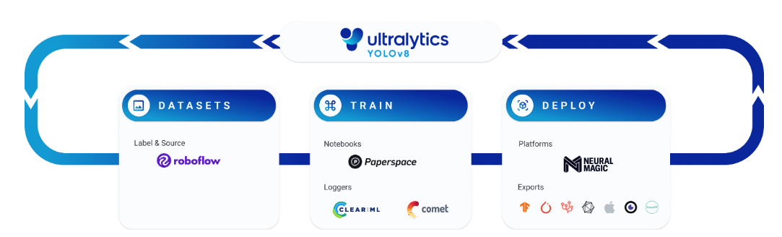
YOLOv8 fine-tuning
YOLOv8 places the power of AI in the hands of everyone.
https://docs.ultralytics.com/modes/
Notes:
Yolov8 places the power of AI in everyone’s hands it is easy for us to train the model on our own dataset to perform face detection tasks.

Slide 17
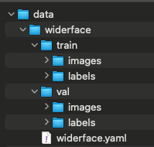
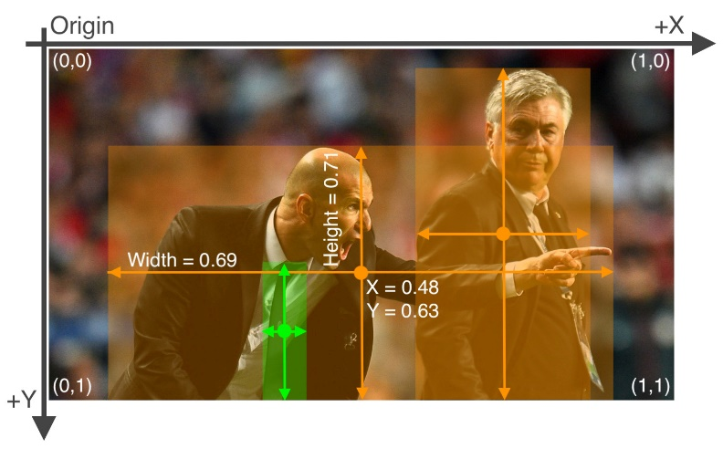
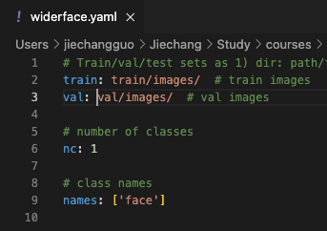
WIDER FACE for YOLO
Create YOLO style dataset.yaml
Organize directories in YOLO style
Convert Wilder Face labels to YOLO format: class x_center y_center width height
Example of YOLO bbox
[1]https://docs.ultralytics.com/yolov5/tutorials/train_custom_data
Notes:
In order to train or fine-tune YOLOv8, we need to prepare the dataset to yolo style. A dataset.yaml file is needed to let YOLO know where our images are, and how many classes the model needs to predict, they will find the label of image automatically if we organize the directories in YOLO style. The bounding box label of WiderFace is different from YOLO’s label, thus we need to convert them.

Slide 18
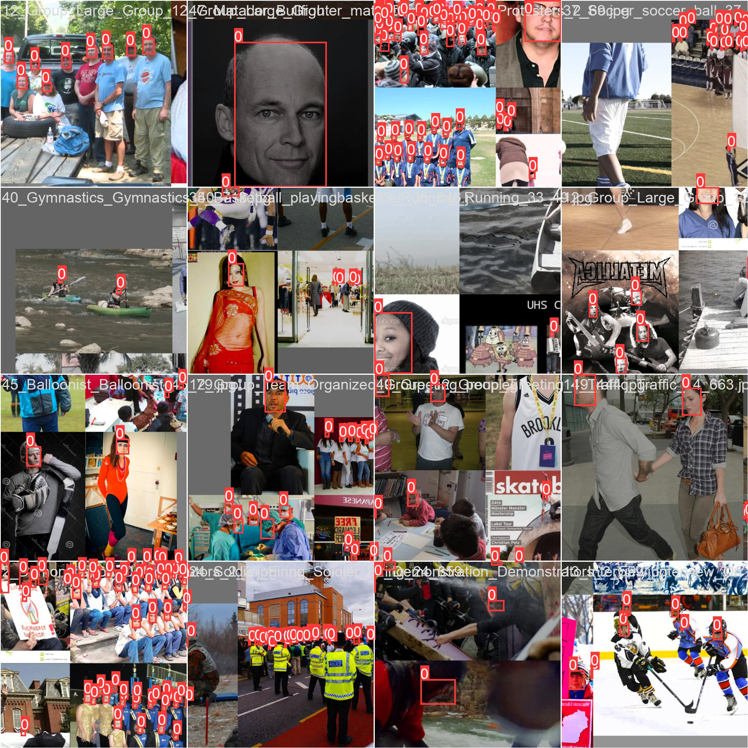
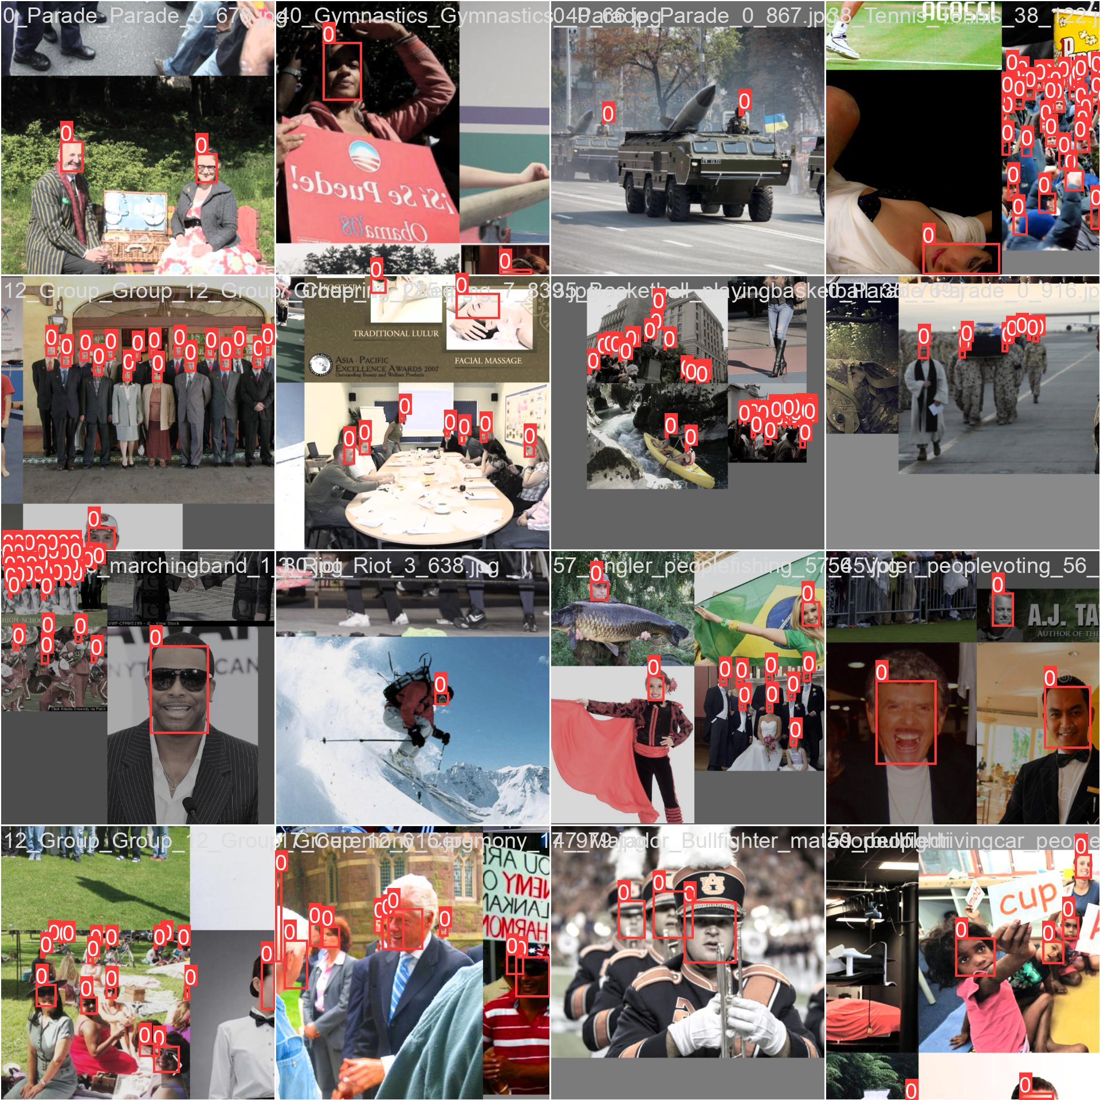
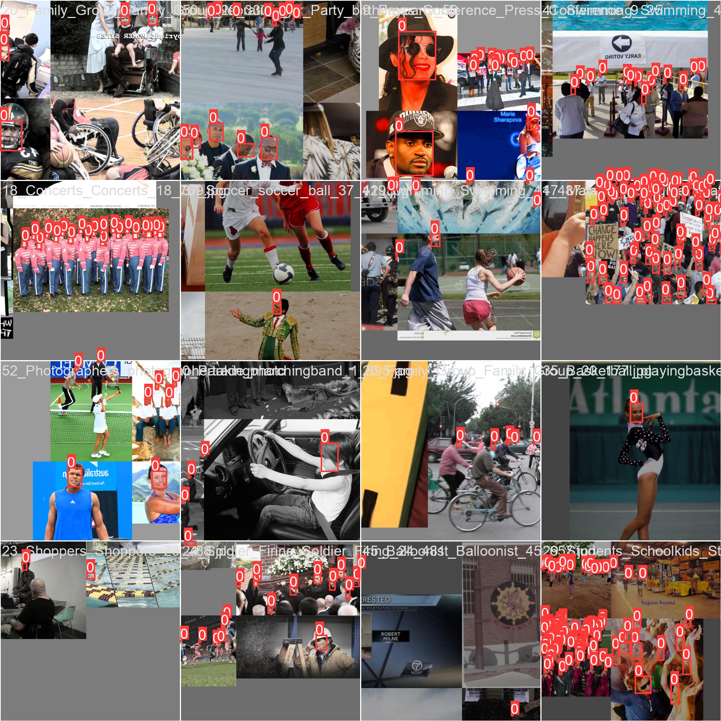
Fine-tune Detail
Fine-tune from pre-trained weights
Optimizer: SGD(lr=0.01)
Train dataset: 12880 images
Batch size: 16
Epochs: 30
Training time: 1.395 hours
Device: NVIDIA A100-SXM4-40GB
Model weight size: 6.2MB
Notes:
Here is our fine-tune details,

Slide 19
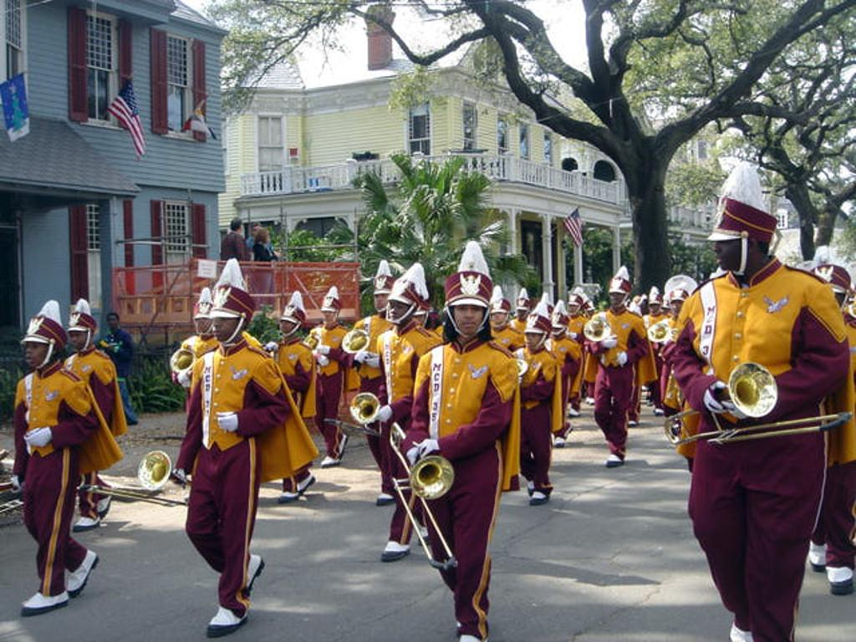

YOLOv8 fine-tuning on the enhanced image
Enhance images labeled as heavy blur (30%) using Super-resolution
Hypothesis: After applying super-resolution, the faces at long distances become clearer, thus, the detection rate increased
Notes:
The reason we want to train the model on the enhanced image is that the faces in long-distance usually are in low resolution, we assume that, After applying super-resolution, the faces at long distances become clearer, thus, the detection rate increased
However, during the experiments we found out that it may not be helpful.

Slide 20
How Super Resolution Work?
Original Image
Notes:
Here is how super resolution work.
Given a blur original image,

Slide 21
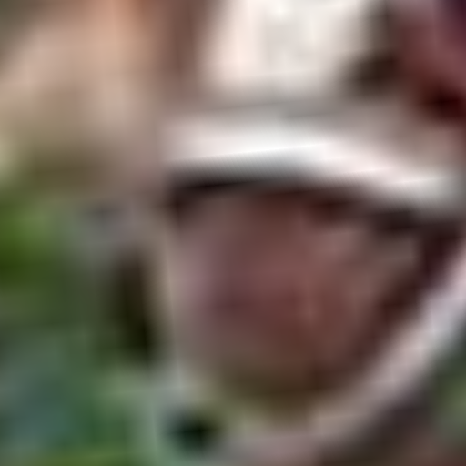

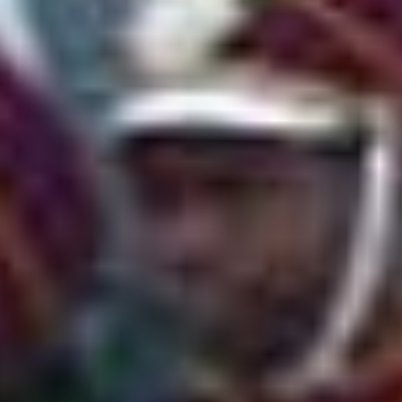
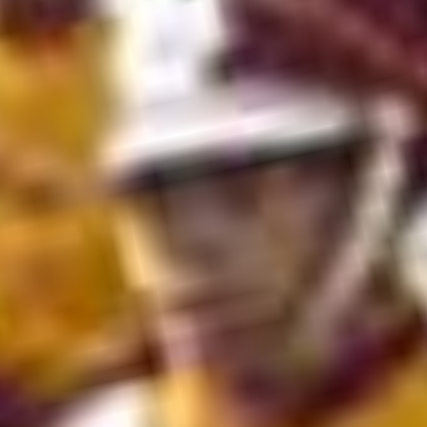
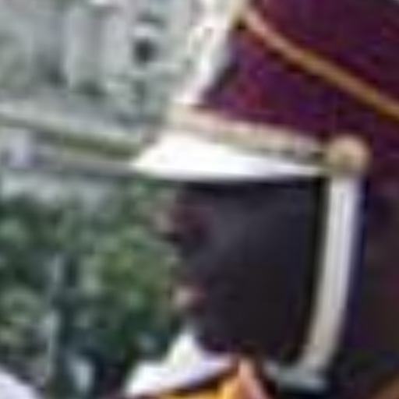
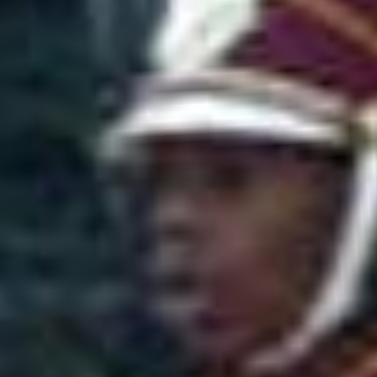
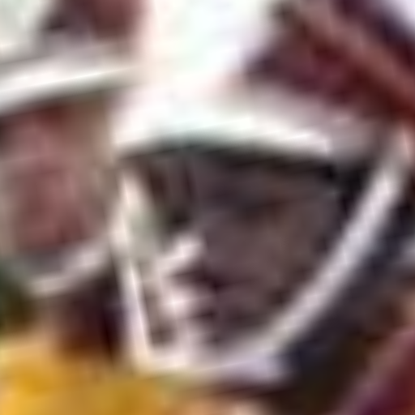
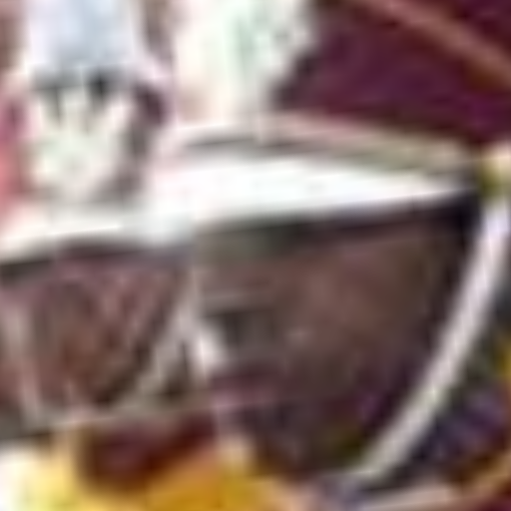
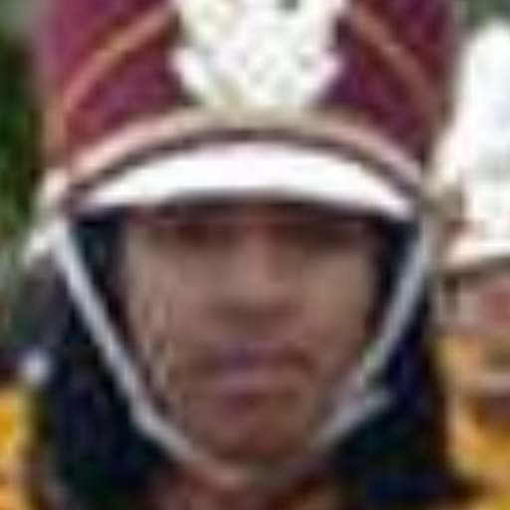
How Super Resolution Work?
retinaface_resnet50: Detected faces
Notes:
It first detect the faces in the image using RetinaFace

Slide 22
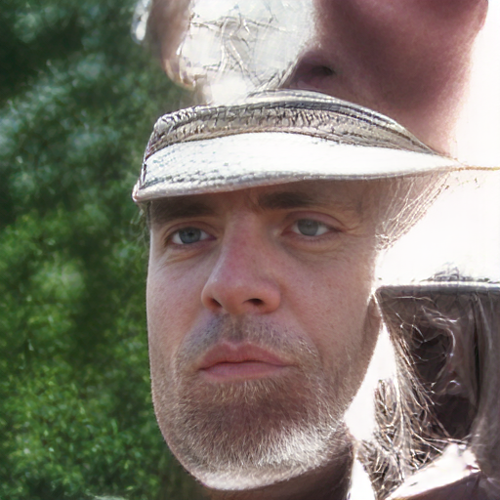
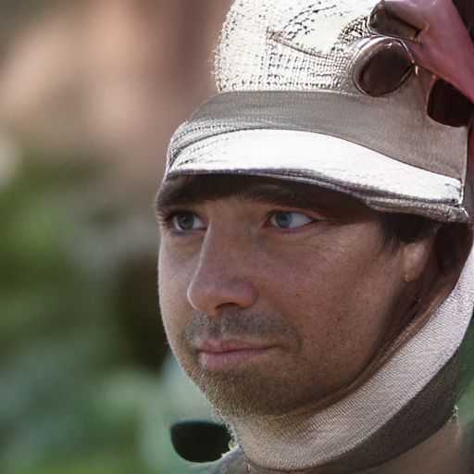
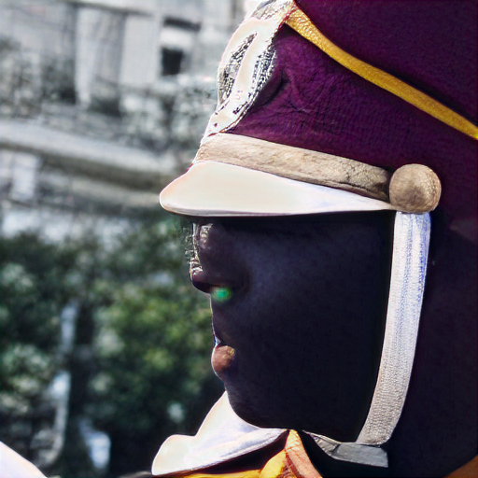
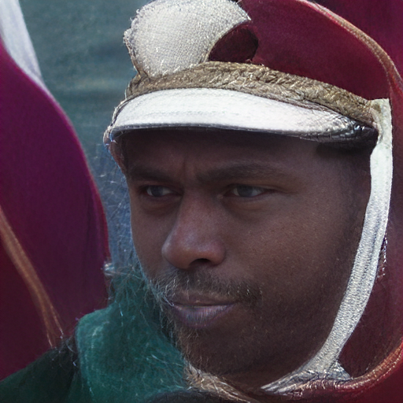
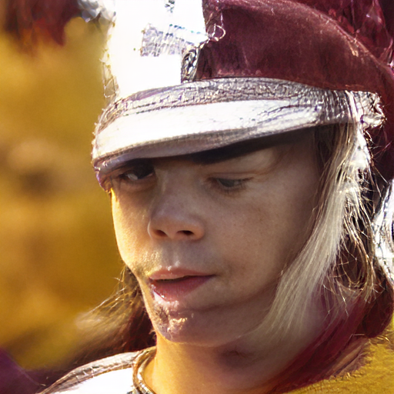
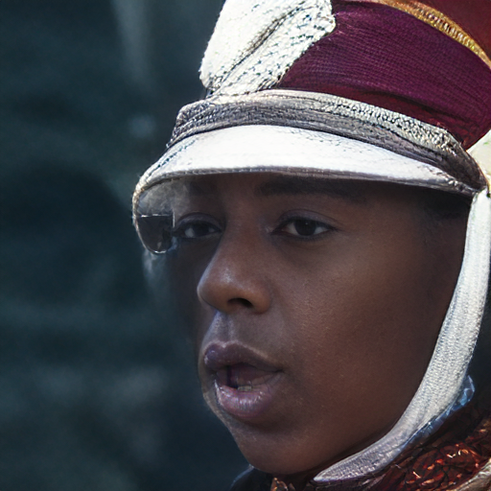
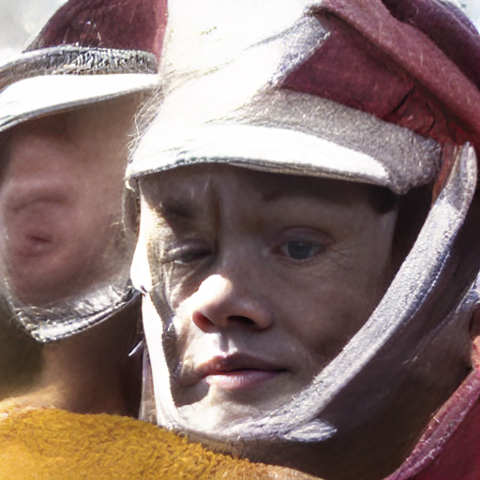
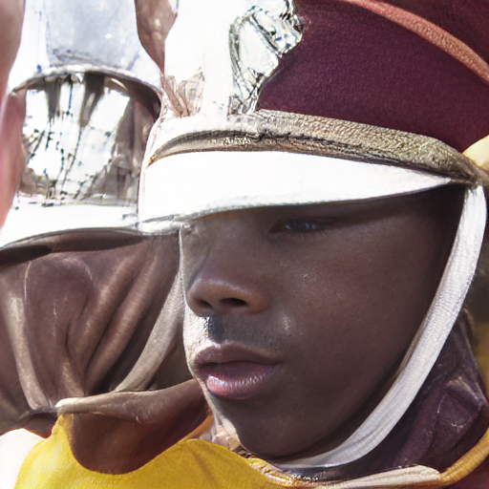
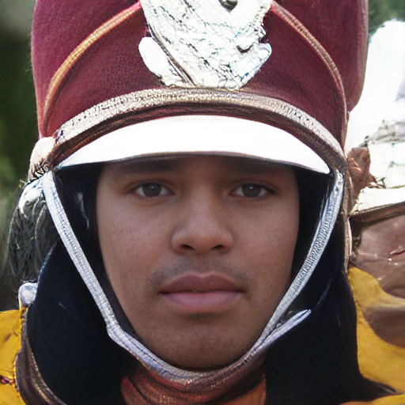
How Super Resolution Work?
Result image
Notes:
Then enhanced the detail of the detected faces.
The rest will be considered as background and reconstructed to objects with similar colors and shapes.

Slide 23
How Super Resolution Work?
Faces not detected were reconstructed to other objects
Notes:
Here is the result that the faces not detected were reconstructed to other objects.
What we expected is the super-resolution could help us enhance the detail of the heavy blur faces so that they can be detected,
however, now we know how it works, itself depends on a face detection model, thus the result may not be as expected

Slide 24
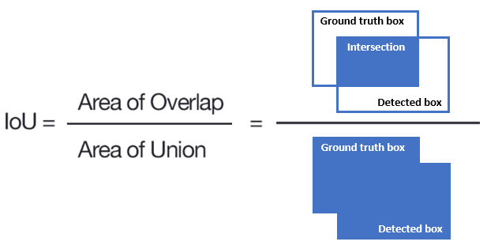
Evaluation
Intersection over Union (IoU) : accuracy of the detection
https://www.baeldung.com/cs/object-detection-intersection-vs-union
Notes:
The typical evaluation metric for the task of face detection is Intersection over Union, the IoU is the metric to evaluate the accuracy of the detection, Given a ground-truth bounding box and a detected bounding box, we compute the IoU as the ratio of the overlap and union areas:

Slide 25
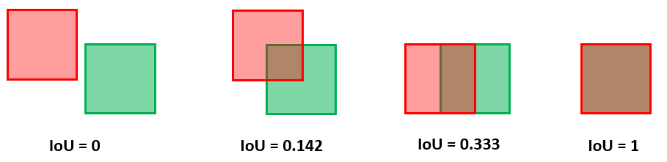
Evaluation
https://www.baeldung.com/cs/object-detection-intersection-vs-union
Notes:
Here are some examples of IoU.
The IoU can have any value between 0 and 1. If two boxes do not intersect, the IoU is 0. On the other hand, if they completely overlap, the IoU is 1.
Therefore, the higher the IoU, the better the prediction of a face detection system.

Slide 26
Evaluation
False Positive
True Positive
https://www.baeldung.com/cs/object-detection-intersection-vs-union
Notes:
The threshold of IoU is usually set to 0.5.
If the IoU score is above the threshold, the detection is considered a true positive.
If the score is below the threshold, the detection is considered a false positive.

Slide 27

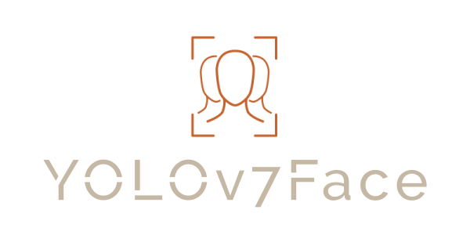
Experiments
Evaluate on validation dataset
5 pre-trained model
Fine-tuned with train dataset
Fine-tuned with enhanced train dataset
YOLOv8-Transformer with train dataset
YOLOv8-Transformer with enhanced trained dataset
Evaluate on validation dataset
https://github.com/msamsami/yolov7face/blob/main/logo.png
https://docs.ultralytics.com/
Notes:
We performed the experiments first on the baseline with 5 pre-trained model to evaluate on validation dataset.
And fine-tune Yolov8

Slide 28
Baseline – YOLOv7 Face evaluation
Test on 5 models provided by the authors (trained by default 300 epochs)
img_size: 640, validation data size: 3226, iou_threshold: 0.5
Models | Size | layers | Parameters | Easy | Medium | Hard | Time(ms)
yolov7-lite-t | 747KB | 236 | 251795 | 88.67 | 85.19 | 71.44 | 96.96
yolov7-lite-s | 2.4MB | 276 | 1073667 | 92.67 | 89.88 | 78.53 | 187.12
yolov7-tiny | 12.4MB | 224 | 6048051 | 94.73 | 92.57 | 82.09 | 328.74
yolov7s | 8.9MB | 297 | 4269124 | 94.81 | 93.13 | 85.18 | 383.40
yolov7 | 73.6MB | 315 | 36562547 | 96.93 | 95.56 | 88.05 | 1670.07
Notes:
We evaluated the baseline with pre-trained 5 models, they didn't mention the detail of the training, after checking their code by default the model will be trained for 300 epochs. The results are shown in this figure. they got a relatively high results on the yolov7 model, however, the test time is quite long compared to the lite model

Slide 29
Results
Models | Size | layers | Parameters | Easy | Medium | Hard | Time(ms)
yolov7-lite-t | 747KB | 236 | 251795 | 88.67 | 85.19 | 71.44 | 96.96
yolov7-lite-s | 2.4MB | 276 | 1073667 | 92.67 | 89.88 | 78.53 | 187.12
yolov7-tiny | 12.4MB | 224 | 6048051 | 94.73 | 92.57 | 82.09 | 328.74
yolov7s | 8.9MB | 297 | 4269124 | 94.81 | 93.13 | 85.18 | 383.40
yolov7 | 73.6MB | 315 | 36562547 | 96.93 | 95.56 | 88.05 | 1670.07
yolov8 | 6.2MB | 225 | 3011043 | 93.29 | 90.83 | 75.67 | 69.57
yolov8-SR | 6.2MB | 225 | 3011043 | 93.25 | 90.92 | 75.46 | 67.99
Yolov8-tr | 11.7MB | 246 | 6070243 | 92.12 | 89.92 | 74.25 | 306.25
Yolov8-tr-SR | 11.7MB | 246 | 6070243 | 92.12 | 89.71 | 73.99 | 304.93
Notes:
In the table, the cells in blue is the result for the baseline. We can observe that with the increase of the model size and layers, parameters the result on easy, medium and hard task increased as well as the inference time.
The cells in orange are the model we trained. The models trained only for 30 epochs show competitive results with our baseline with an acceptable size of the model and inference time.
We believe that if we train the model for more epochs, we may get better results.

Slide 30
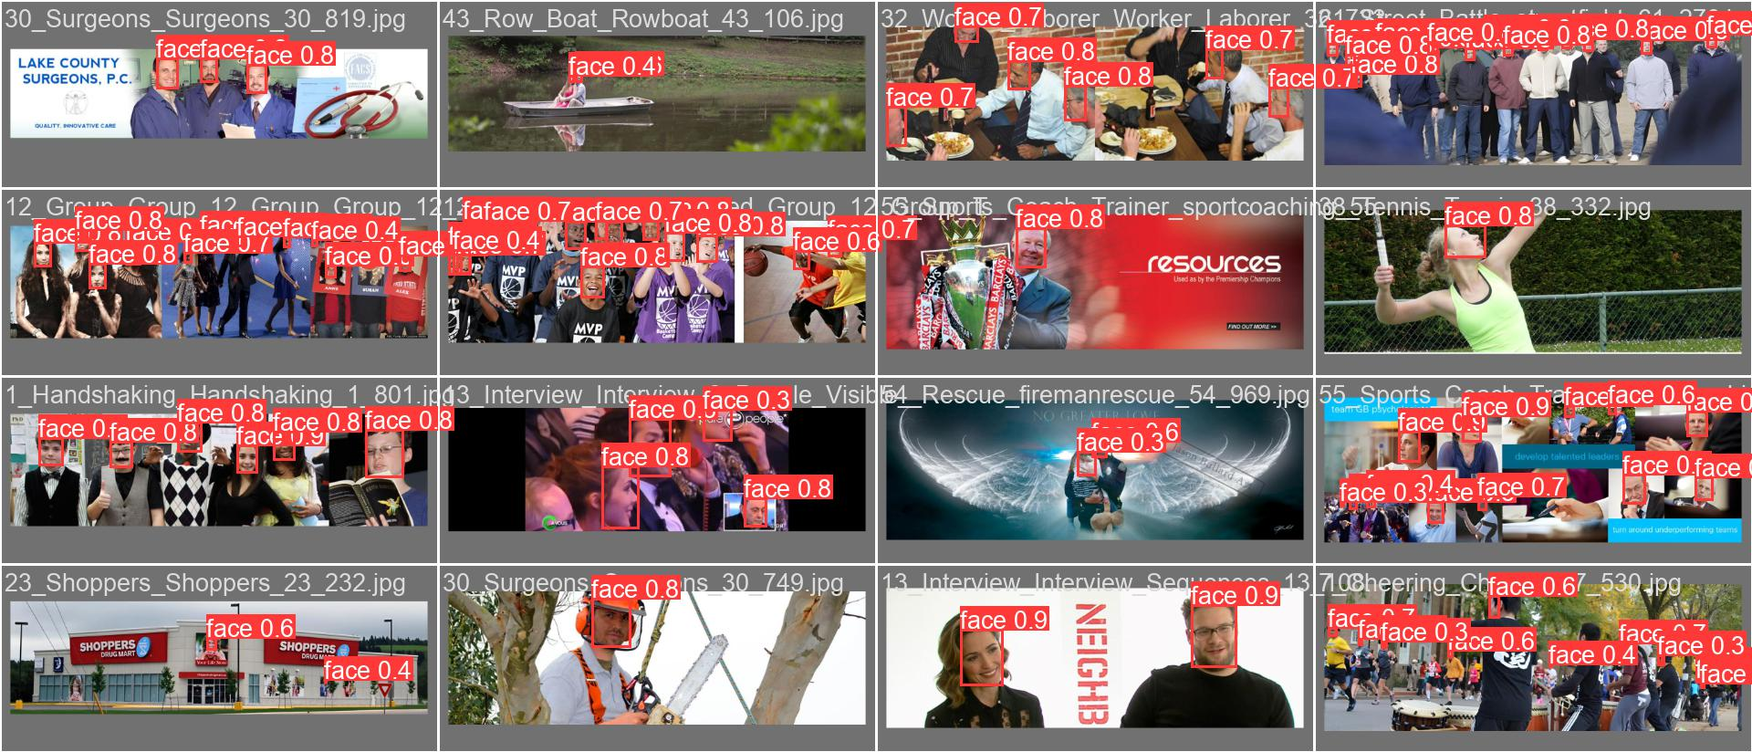
Result – YOLOv8

Slide 31
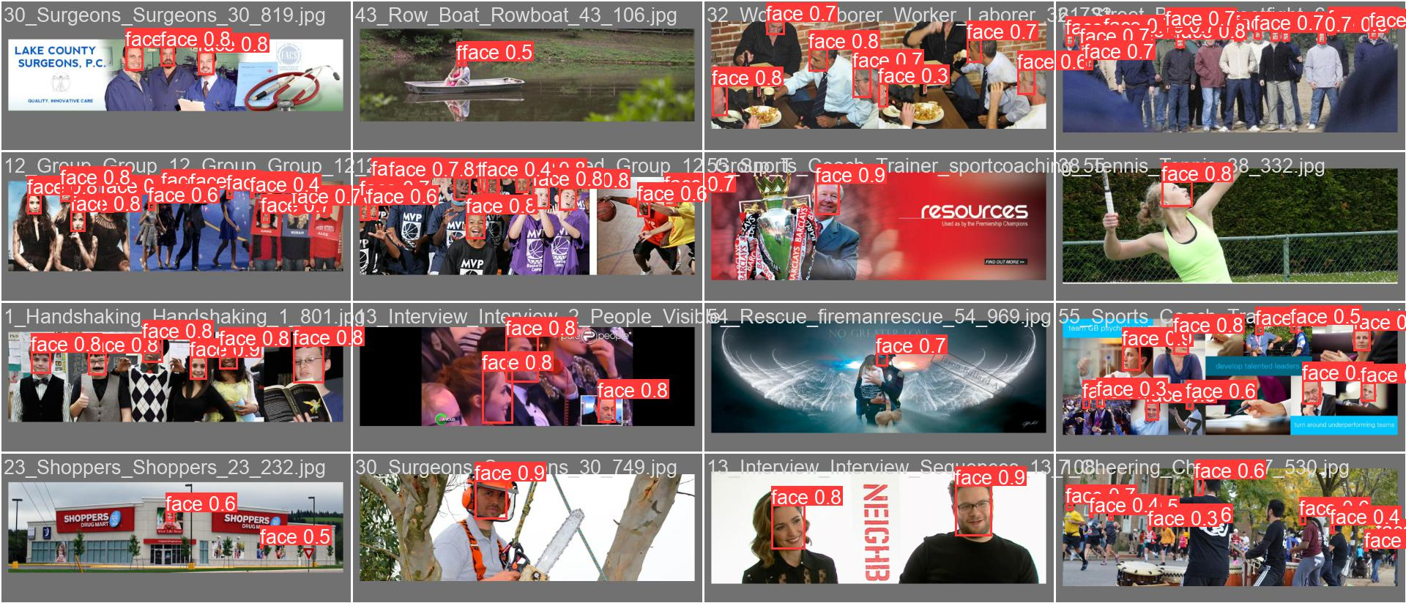
Result – YOLOv8 with super resolution

Slide 32
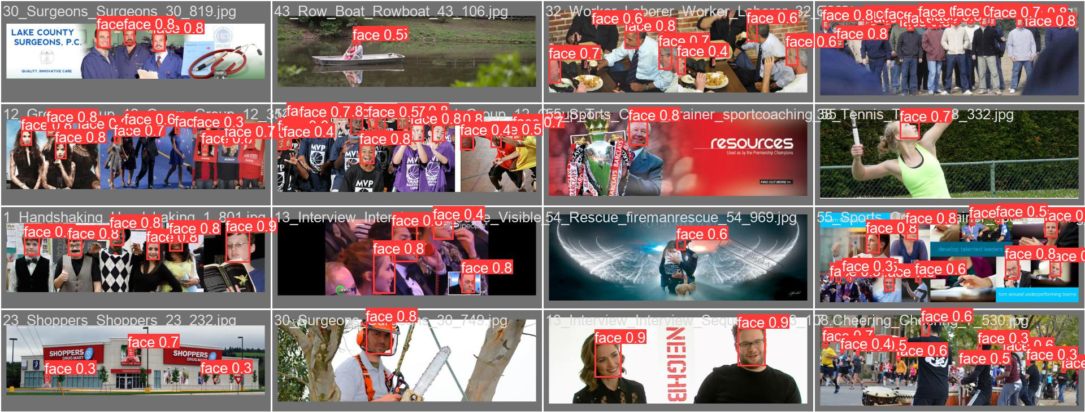
Result – YOLOv8 Transformer

Slide 33
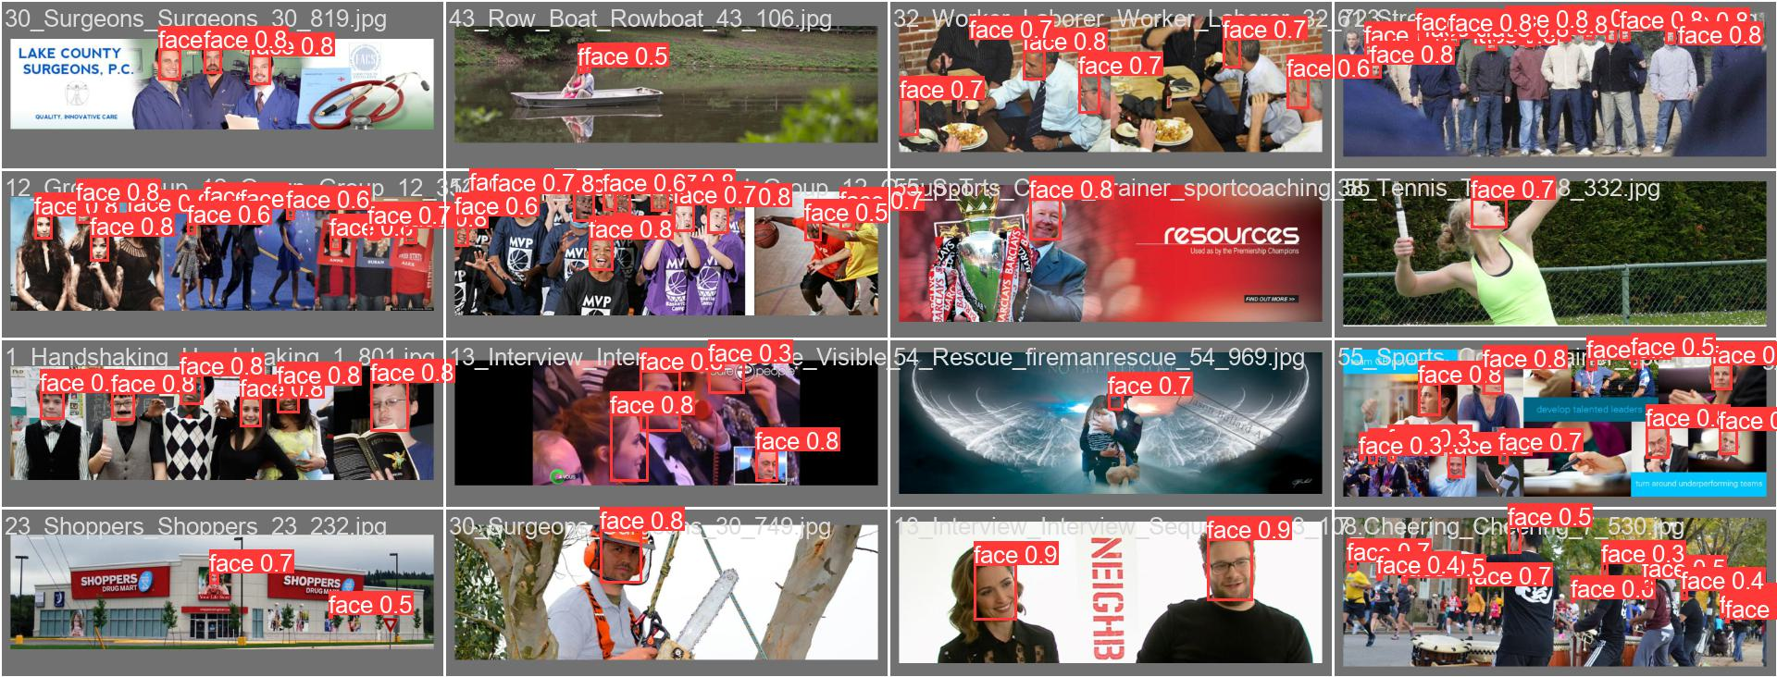
Result – YOLOv8 Transformer – with enhanced

Slide 34
Future work
Fine-tune our model for better performance
Writing complete report
Notes:
Here is our plan, after the midterm presentation, we will first do a baseline evaluation before March 6 and
Take most of our time working on the architecture modification, including fine-tuning on the wilder face before April 3.
And finish the evaluation, before April 17. Then work on the report and presentation for the final submission.

Slide 35
Reference
[1] A. Bochkovskiy, Chien-Yao Wang, Hong-Yuan Mark Liao., “YOLOv5: An Improved Real-Time Object Detection System”. arXiv preprint arXiv:2012.03803. 2020.,https://github.com/ultralytics/yolov5
[2] Zhi Zhang, Shifeng Zhang, Xiaobo Wang, Peihua Li, and Jian Sun “RetinaFace: SingleStageDense Face Localisation in the Wild”, arXiv preprint arXiv:1905.00641. 2019
[3] Shuo Yang, Ping Luo, Chen Change Loy, and Xiaoou Tang, “WIDER FACE: A Face Detection Benchmark.” in Proc. Conference on Computer Vision and Pattern Recognition, 2016
[4] https://ai.googleblog.com/2021/07/high-fidelity-image-generation-using.html.
[5] https://docs.ultralytics.com/yolov5/tutorials/train_custom_data
[6] https://github.com/sczhou/CodeFormer
Notes:
Look at the errors

Slide 36
Thanks for your listening!

Slide 37
Task Assignment
Jiechang Guo
Data Preparation for YOLO, enhanced with Super Resolution
Baseline evaluation
Fine-tune YOLOv8
Fine-tune YOLOv8 on enhanced Data
Meng-Chen Lee
Related work
YOLOv8 architecture modification
Fine-tune YOLOv8 with Transformer
Fine-tune YOLOv8 with Transformer on enhanced data

Slide 38
WIDER FACE enhanced with SuperResolution
Run super resolution on the train and val data
Train dataset: 4496(35%) images enhanced
Val dataset: 1164(36%) images enhanced
From 1024*768 to 2048*1536
Estimated processing time: 15 hours+

